Slide 1
Air Quality Monitoring System

Slide 2
AQM:
The Air Quality Monitoreing(AQM) is focuses on the design and implementation of an IoT based Air Quality Index Monitoring System that we have intended to develop using ESP 32 microcontroller.
The setup is going to show the air quality in PPM, temperature, and humidity with the help of various sensors and further, it would be displayed on the IoT Platform, ThingSpeak.

Slide 3
Internet Of Things(IOT):
The Internet of Things, or IoT, is a network of physical devices.
These devices can transfer data to one another without human intervention.
IoT devices are not limited to computers or machinery.
The Internet of Things can include anything with a sensor that is assigned a unique identifier (UID).
The primary goal of the IoT is to create self-reporting devices that can communicate with each other in real time.

Slide 4
ESP 32:
ESP32 is a series of low-cost, low-power system on a chip (SoC) microcontrollers with integrated Wi-Fi and dual-mode Bluetooth.
It is developed by Espressif Systems and launched in September 2016.
It has a dual-core 32-bit Xtensa LX6 microprocessor and various features such as antenna switches, RF balun, power amplifier, filters, and power management modules.
It is a successor to the ESP8266 SoC and a popular choice for IoT applications.

Slide 5
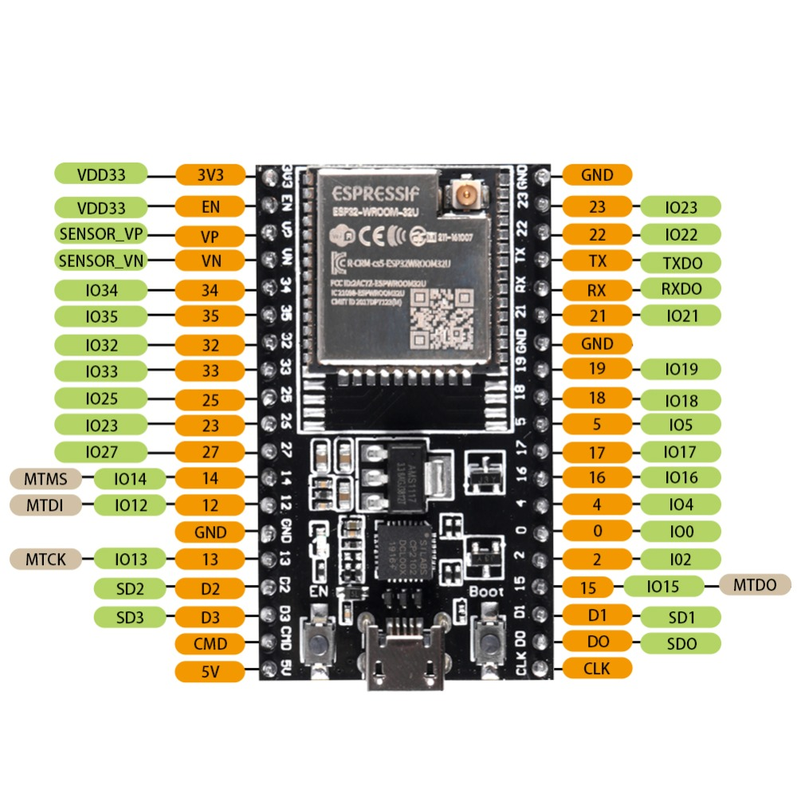

Slide 6
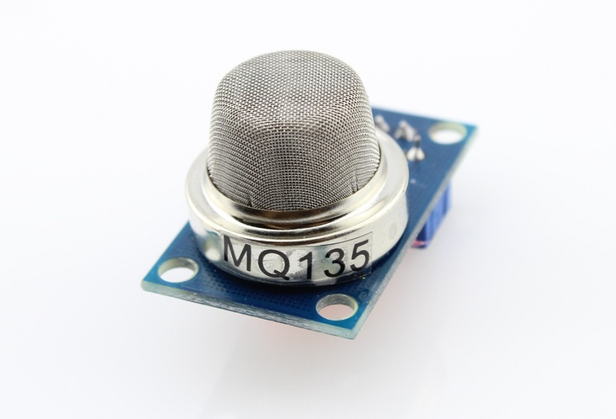
MQ135:
The MQ135 sensor is a type of air quality gas sensor that is used to detect, measure, and monitor a wide range of gases present in the air like ammonia, alcohol, benzene, smoke, carbon dioxide, etc.
It operates at a 5V supply with 150mA consumption. Preheating of 20 seconds is required before the operation, to obtain the accurate output.

Slide 7
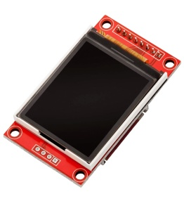
OVERVIEW:
1. Home Page:
A dynamic map showing air quality data from various locations.
Users can zoom in/out and click on specific locations to get more detailed data.
A search bar for users to find specific locations.
Real-time air quality index (AQI) displayed prominently.
2. Location-specific Page:
Detailed air quality data for the selected location, including levels of different pollutants (PM2.5, PM10, NO2, SO2, CO, O3).
Historical data and trends over time.
Health advisories based on current air quality.
3. Data Page:
Allows users to download raw data for their own analysis.
Provides APIs for developers to access and use the data.
4. About Page:
Information about the platform, data sources, how the AQI is calculated, etc.
5. User Account:
Users can create an account to save their favorite locations and set up notifications for AQI changes and watch it through the TFT display .
Remember, this is just a basic design. Depending on your specific needs and resources, you might want to add more features or details. For example, you could add a feature that predicts future air quality based on historical data and weather forecasts. Or you could provide more detailed health advisories, like recommending when to wear masks or when it’s safe to exercise outdoors. You could also consider making the platform mobile-friendly or developing a mobile app version.

